Slide 1


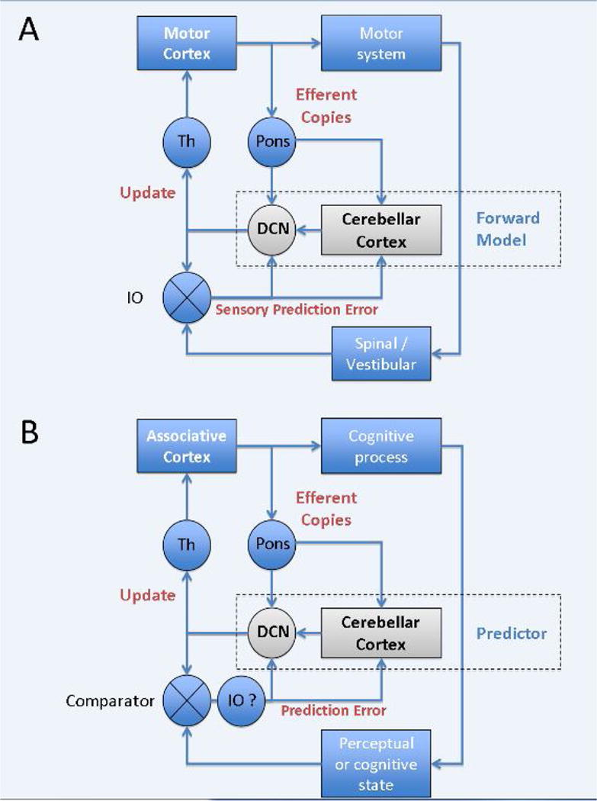
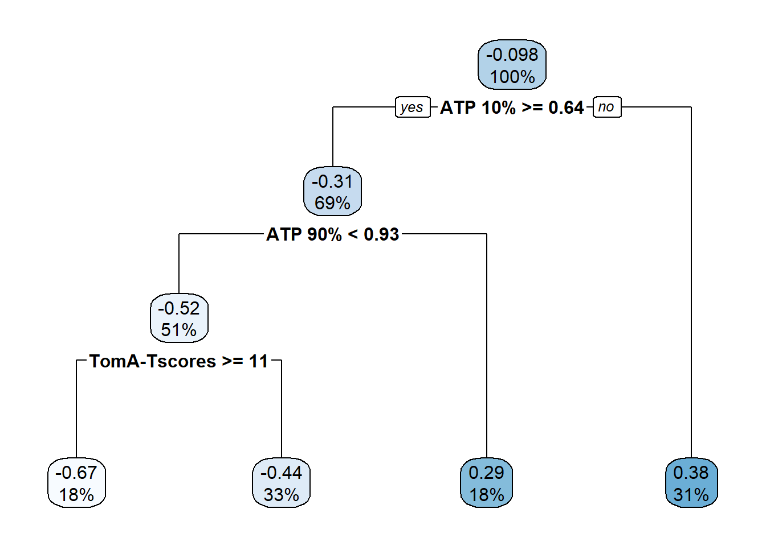
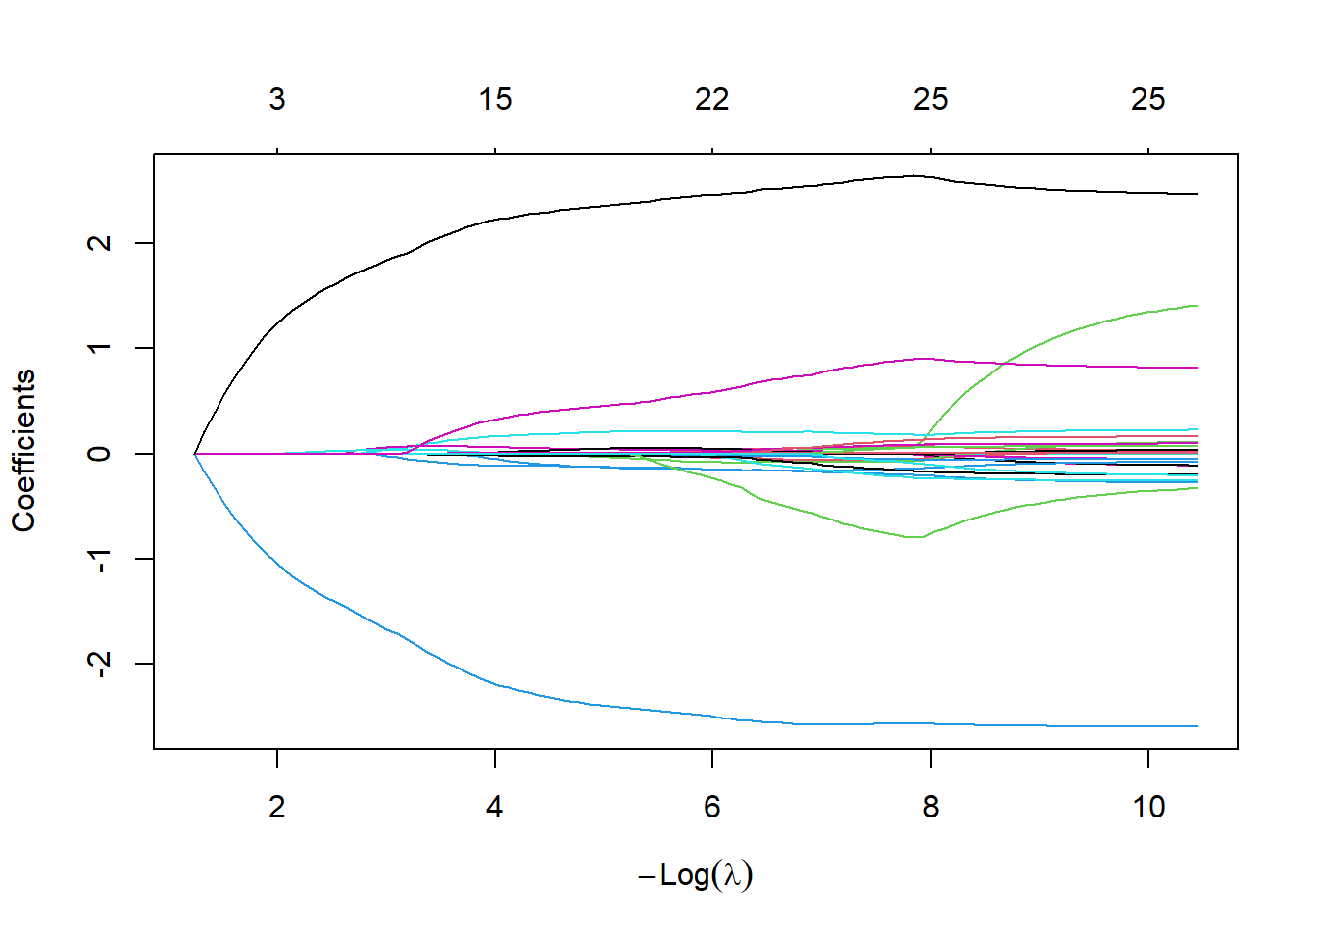
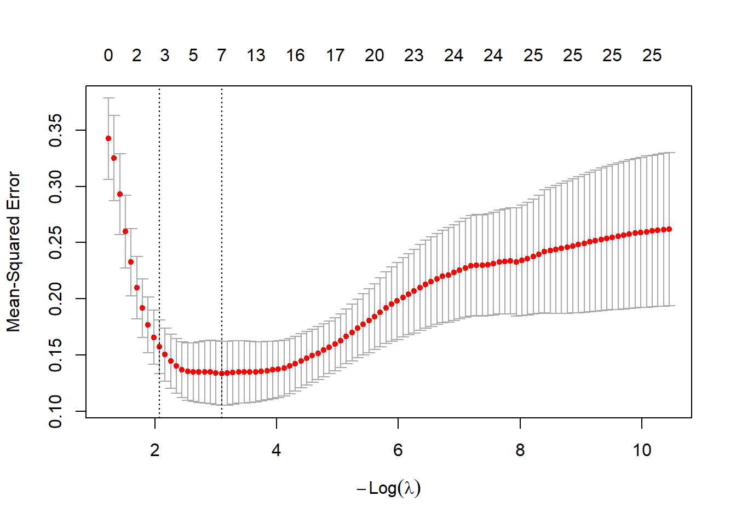
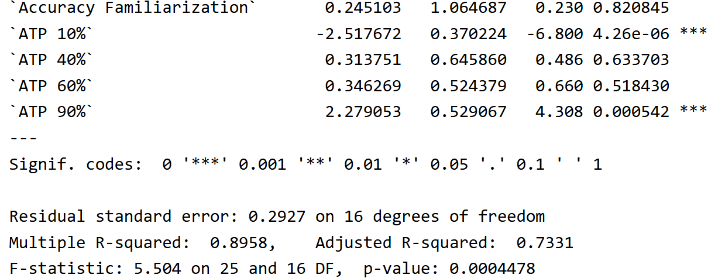
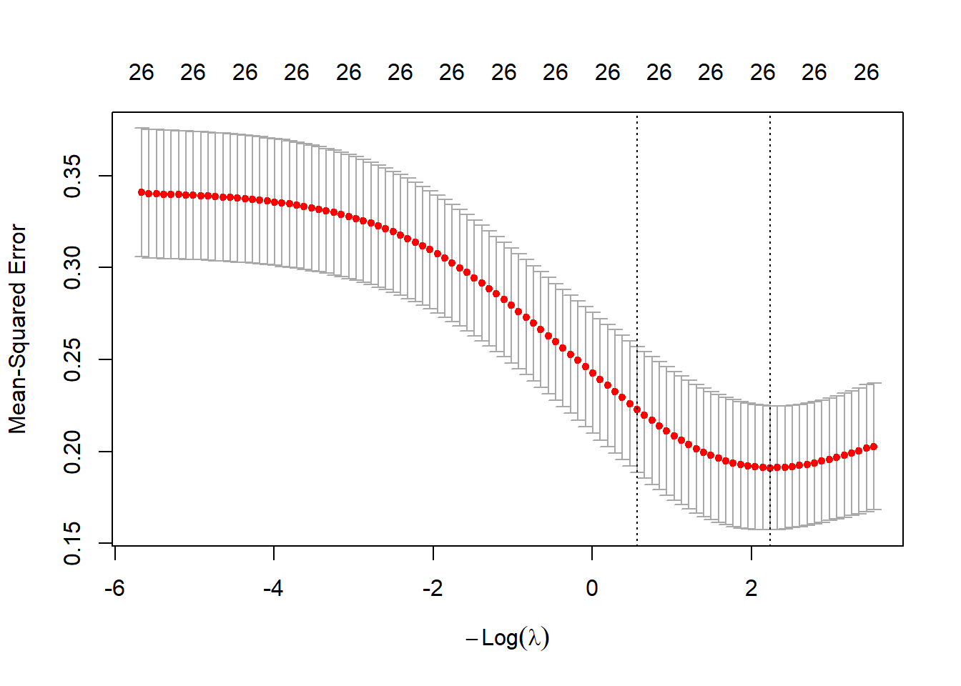
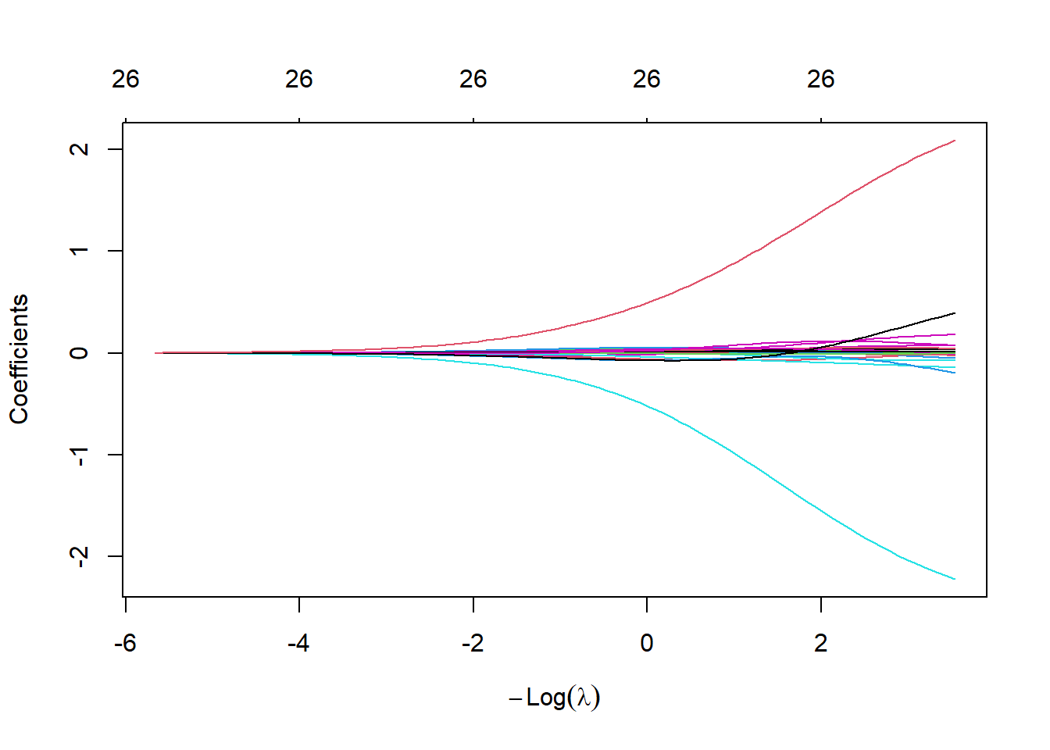
PREDICTING DEFICITS IN ACTION PREDICTION FROM TUMOR LOCATION
Sally Henley, Ogechi Onyewu, Rebecca Tegiacchi
BACKGROUND
REBECCA
Universal Cerebellar Transform Theory: the cerebellum uses prediction and error signaling from inputs in the cerebro-cerebellar loops to generate models used for action prediction
Step 3: Principal Components Analysis
Step 7: Decision Trees
PCA seeks a small number of variables that are as interesting as possible, removing multicollinearity and providing low variance
PCA MSE = 0.431
Supervised method that allows for visualization of decision rules
Tree MSE = 0.998 (very high)
Step 4: Partial Least Squares
Supervised method of obtaining principal components, used to improve the prediction of the response.
PLS MSE = 0.393
Sokolov et al. 2017
DATA SET
Step 5: Lasso
From Butti et al. 2020
N=61 patients with either supratentorial, infratentorial or no lesion (N=21 each)
Least absolute selection and shrinkage operator, uses the L1 norm to minimize SSE
Lasso MSE = 0.300
Step 8: KNN
Supervised method that predicts based on proximity to group
KNN MSE = 0.221
RESEARCH QUESTION AND HYPOTHESES
LASSO
Can we predict performance accuracy on an action prediction task based on lesion location within the brain?
Step 9: SVM
Supervised method that finds a hyperplane to maximize distance between each class
SVM MSE = 0.132
Step 1: Assessing Multicollinearity using linear regression
CONCLUSIONS
Step 6: Ridge
Comparing the model types shows that SVM methods are the best for our data set, having the smallest error.
Overall, the models show that ATP 10% and 40% are the best predictors of performance accuracy, lesion location was not significant in our models.
Recommendations:
Increase sample size
Include age of lesion to assess developmental outcomes
Helps reduce multicollinearity and the variance of estimates by constraining the coefficient estimates toward 0
Ridge MSE = 0.248
Removed: Age, AgeMonths, Age at diagnosis, Time since diagnosis, Tumor type, Affect Rec. Raw scores
Step 2: Resampling using Bootstrap
REFERENCES
Bootstrapping allows us to improve the stability of regression and classification models and reduces variance and the chance of overfitting.
B = 500, Bootstrap MSE = 0.336
Butti, N., Corti, C., Finisguerra, A., Bardoni, A., Borgatti, R., Poggi, G., & Urgesi, C. (2020). Cerebellar damage affects contextual priors for action prediction in patients with childhood brain tumor. Cerebellum (London, England), 19(6), 799–811. https://doi.org/10.1007/s12311-020-01168-w
Glaser, J. I., Benjamin, A.S., Farhoodi, R., Kording, K.P. (2019). The roles of supervised machine learning in systems neuroscience. Progress in Neurobiology, 175, 126-137. https://doi.org/10.1016/j.pneurobio.2019.01.008.
Stoodley, C. J., MacMore, J. P., Makris, N., Sherman, J. C., & Schmahmann, J. D. (2016). Location of lesion determines motor vs. cognitive consequences in patients with cerebellar stroke. NeuroImage. Clinical, 12, 765–775. https://doi.org/10.1016/j.nicl.2016.10.013
Stoodley, C. J., & Schmahmann, J. D. (2010). Evidence for topographic organization in the cerebellum of motor control versus cognitive and affective processing. Cortex; a journal devoted to the study of the nervous system and behavior, 46(7), 831–844. https://doi.org/10.1016/j.cortex.2009.11.008
e, Q., Wang, S., Zhu, J., Zhang, X. (2016). Modeling and predicting AD progression by regression analysis of sequential clinical data. Neurocomputing, 195. 50-55. https://doi.org/10.1016/j.neucom.2015.07.145.

Slide 2
PREDICTING DEFICITS IN ACTION PREDICTION FROM TUMOR LOCATION
Sally Henley, Ogechi Onyewu, Rebecca Tegiacchi
BACKGROUND
SALLY
Universal Cerebellar Transform Theory: the cerebellum uses prediction and error signaling from inputs in the cerebro-cerebellar loops to generate models used for action prediction
Step 3: Principal Components Analysis
Step 7: Decision Trees
PCA seeks a small number of variables that are as interesting as possible, removing multicollinearity and providing low variance
PCA MSE = 0.431
Supervised method that allows for visualization of decision rules
Tree MSE = 0.998 (very high)
Step 4: Partial Least Squares
Supervised method of obtaining principal components, used to improve the prediction of the response.
PLS MSE = 0.393
Sokolov et al. 2017
DATA SET
Step 5: Lasso
From Butti et al. 2020
N=61 patients with either supratentorial, infratentorial or no lesion (N=21 each)
Least absolute selection and shrinkage operator, uses the L1 norm to minimize SSE
Lasso MSE = 0.300
Step 8: KNN
Supervised method that predicts based on proximity to group
KNN MSE = 0.221
RESEARCH QUESTION AND HYPOTHESES
LASSO
Can we predict performance accuracy on an action prediction task based on lesion location within the brain?
Step 9: SVM
Supervised method that finds a hyperplane to maximize distance between each class
SVM MSE = 0.132
Step 1: Assessing Multicollinearity using linear regression
CONCLUSIONS
Step 6: Ridge
Comparing the model types shows that SVM methods are the best for our data set, having the smallest error.
Overall, the models show that ATP 10% and 40% are the best predictors of performance accuracy, lesion location was not significant in our models.
Recommendations:
Increase sample size
Include age of lesion to assess developmental outcomes
Helps reduce multicollinearity and the variance of estimates by constraining the coefficient estimates toward 0
Ridge MSE = 0.248
Removed: Age, AgeMonths, Age at diagnosis, Time since diagnosis, Tumor type, Affect Rec. Raw scores
Step 2: Resampling using Bootstrap
REFERENCES
Bootstrapping allows us to improve the stability of regression and classification models and reduces variance and the chance of overfitting.
B = 500, Bootstrap MSE = 0.336
Butti, N., Corti, C., Finisguerra, A., Bardoni, A., Borgatti, R., Poggi, G., & Urgesi, C. (2020). Cerebellar damage affects contextual priors for action prediction in patients with childhood brain tumor. Cerebellum (London, England), 19(6), 799–811. https://doi.org/10.1007/s12311-020-01168-w
Glaser, J. I., Benjamin, A.S., Farhoodi, R., Kording, K.P. (2019). The roles of supervised machine learning in systems neuroscience. Progress in Neurobiology, 175, 126-137. https://doi.org/10.1016/j.pneurobio.2019.01.008.
Stoodley, C. J., MacMore, J. P., Makris, N., Sherman, J. C., & Schmahmann, J. D. (2016). Location of lesion determines motor vs. cognitive consequences in patients with cerebellar stroke. NeuroImage. Clinical, 12, 765–775. https://doi.org/10.1016/j.nicl.2016.10.013
Stoodley, C. J., & Schmahmann, J. D. (2010). Evidence for topographic organization in the cerebellum of motor control versus cognitive and affective processing. Cortex; a journal devoted to the study of the nervous system and behavior, 46(7), 831–844. https://doi.org/10.1016/j.cortex.2009.11.008
e, Q., Wang, S., Zhu, J., Zhang, X. (2016). Modeling and predicting AD progression by regression analysis of sequential clinical data. Neurocomputing, 195. 50-55. https://doi.org/10.1016/j.neucom.2015.07.145.

Slide 3

PREDICTING DEFICITS IN ACTION PREDICTION FROM TUMOR LOCATION
Sally Henley, Ogechi Onyewu, Rebecca Tegiacchi
BACKGROUND
OGECHI
Universal Cerebellar Transform Theory: the cerebellum uses prediction and error signaling from inputs in the cerebro-cerebellar loops to generate models used for action prediction
Step 3: Principal Components Analysis
Step 7: Decision Trees
PCA seeks a small number of variables that are as interesting as possible, removing multicollinearity and providing low variance
PCA MSE = 0.431
Supervised method that allows for visualization of decision rules
Tree MSE = 0.998 (very high)
Step 4: Partial Least Squares
Supervised method of obtaining principal components, used to improve the prediction of the response.
PLS MSE = 0.393
Sokolov et al. 2017
DATA SET
Step 5: Lasso
From Butti et al. 2020
N=61 patients with either supratentorial, infratentorial or no lesion (N=21 each)
Least absolute selection and shrinkage operator, uses the L1 norm to minimize SSE
Lasso MSE = 0.300
Step 8: KNN
Supervised method that predicts based on proximity to group
KNN MSE = 0.221
RESEARCH QUESTION AND HYPOTHESES
LASSO
Can we predict performance accuracy on an action prediction task based on lesion location within the brain?
Step 9: SVM
Supervised method that finds a hyperplane to maximize distance between each class
SVM MSE = 0.132
Step 1: Assessing Multicollinearity using linear regression
CONCLUSIONS
Step 6: Ridge
Comparing the model types shows that SVM methods are the best for our data set, having the smallest error.
Overall, the models show that ATP 10% and 40% are the best predictors of performance accuracy, lesion location was not significant in our models.
Recommendations:
Increase sample size
Include age of lesion to assess developmental outcomes
Helps reduce multicollinearity and the variance of estimates by constraining the coefficient estimates toward 0
Ridge MSE = 0.248
Removed: Age, AgeMonths, Age at diagnosis, Time since diagnosis, Tumor type, Affect Rec. Raw scores
Step 2: Resampling using Bootstrap
REFERENCES
Bootstrapping allows us to improve the stability of regression and classification models and reduces variance and the chance of overfitting.
B = 500, Bootstrap MSE = 0.336
Butti, N., Corti, C., Finisguerra, A., Bardoni, A., Borgatti, R., Poggi, G., & Urgesi, C. (2020). Cerebellar damage affects contextual priors for action prediction in patients with childhood brain tumor. Cerebellum (London, England), 19(6), 799–811. https://doi.org/10.1007/s12311-020-01168-w
Glaser, J. I., Benjamin, A.S., Farhoodi, R., Kording, K.P. (2019). The roles of supervised machine learning in systems neuroscience. Progress in Neurobiology, 175, 126-137. https://doi.org/10.1016/j.pneurobio.2019.01.008.
Stoodley, C. J., MacMore, J. P., Makris, N., Sherman, J. C., & Schmahmann, J. D. (2016). Location of lesion determines motor vs. cognitive consequences in patients with cerebellar stroke. NeuroImage. Clinical, 12, 765–775. https://doi.org/10.1016/j.nicl.2016.10.013
Stoodley, C. J., & Schmahmann, J. D. (2010). Evidence for topographic organization in the cerebellum of motor control versus cognitive and affective processing. Cortex; a journal devoted to the study of the nervous system and behavior, 46(7), 831–844. https://doi.org/10.1016/j.cortex.2009.11.008
e, Q., Wang, S., Zhu, J., Zhang, X. (2016). Modeling and predicting AD progression by regression analysis of sequential clinical data. Neurocomputing, 195. 50-55. https://doi.org/10.1016/j.neucom.2015.07.145.

